Slide 1
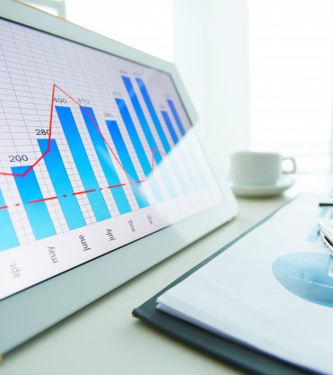
INGLÉS PARA EL TRABAJO
Tema 1: The Verb to be and Present Simple : Review
Todas las carreras

Slide 2
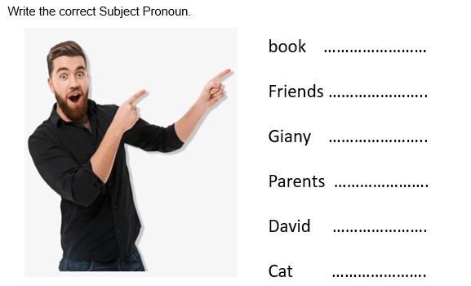
Book (Libro) - "It" (Él/Ella)
Friends (Amigos) - "They" (Ellos/Ellas)
Giany - "She" (Ella)
Parents (Padres) - "They" (Ellos/Ellas)
David - "He" (Él)
Cat (Gato) - "It" (Él/Ella)

Slide 3
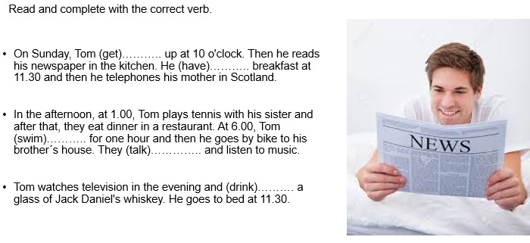
On Sunday, Tom "GETS" up at 10 o 'clock. Then he reads his newspaper in the kitchen. He "HAS" breakfast at 11:30 and then telephones his mother in Scotland.
In the aftermoon, at 1.00, Tom plays tennis with his is sister and after that, they eat dinner in a restaurant. At 6:00. Tom "SWIMS" for one hour and then he goes by like to his brother's house. They "TALK" and listen to music.
Tom watches television in the evening and "DRINKS" a glass of Jack Daniel's whiskey. He goes to bed at 11:30.

Slide 4
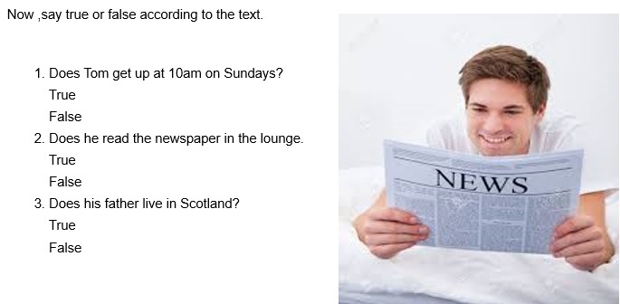
Now, say true or false according to the text.
Does Tom get up at 10am on Sunday?
true
false
Does he read the newspaper in the lounge.
true
false
Does his father live in Scotland?
true
false

Slide 5
Thanks!

